Slide 1
Public and Private Key Encryption

Slide 2
Encryption
Encryption is the process of taking data and encoding it into a form that cannot be read by unauthorized people
In technical terms, it is the process of converting a human-readable text and converting it into an incomprehensible text(ciphertext) using a cryptographic key.

Slide 3
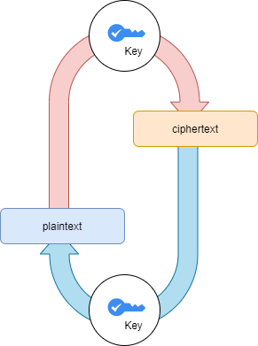
What is a Key?
A key is a string of random characters, specifically used within an encryption algorithm to scramble the data and to unscramble the data in the decryption algorithm.
Every key should be unique

Slide 4

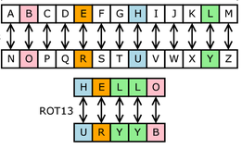
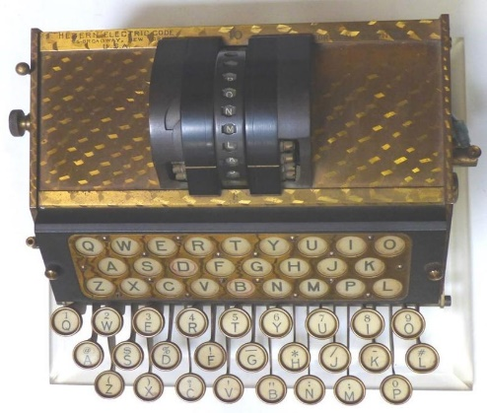
History of Encryption
600 BC: Spartans used scytale to send secrete messages during battles.
60 BC: Julius Caesar invented a substitution cipher that shifted charterers by three places
1917: Edward Hebern invented the electro-mechanical encryption machine using a typewriter and a rotating disc. It encoded a substitution table that changed every time a new character was typed.

Slide 5

History of Encryption Continued…
1945: Claude E. Shannon published an article on the mathematical theory of cryptography. A starting point of modern cryptography.
1970’s: IBM formed a crypto group to protect customer’s data.
1976: Whitfield Diffie and Martin E. Hellman’s developed public-key cryptography, a method to secure messages over insecure channels.

Slide 6
Why is data encryption necessary?
Privacy: Encryption ensures that no one except the owner and receiver can read their communications. This prevents any attackers or any unsecured networks to intercept your messages and read any sensitive data.
Security: Encryption prevents data breaches. If a device is lost or stolen and its hard drive is properly encrypted, the data on that device will still be secure.
Data integrity: Encryption ensures that the data transmitted across the Internet, has not been tampered with on the way. The recipient gets the exact data sent by the sender.
Authentication: Encryption ensures that passwords are not easily hackable.

Slide 7
Private Key Encryption (Symmetric Key Encryption)

Slide 8
Private Key Encryption
Same key is used to encrypt and decrypt data
The key is known only to the owner and the recipient of the data
Faster than public-key encryption because both parties use the same key to encrypt and decrypt the data.
Examples: DES, IDEA, RC5, and CAST

Slide 9
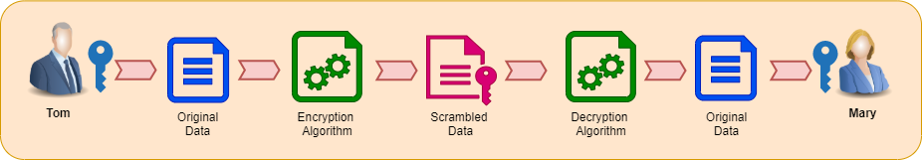
Example
Tom wants to send has sensitive data to Mary. In Symmetric Key Encryption, both Tom and Mary will use the same key to encrypt and decrypt the data.
Tom uses the key and encrypts the data using an encryption algorithm. The encryption algorithm converts plain data to scrambled data. Now, no one can read it.
When Mary gets the encrypted data, she uses the same key and decrypts the data using a decryption algorithm. Now she can read the data in plain text.

Slide 10
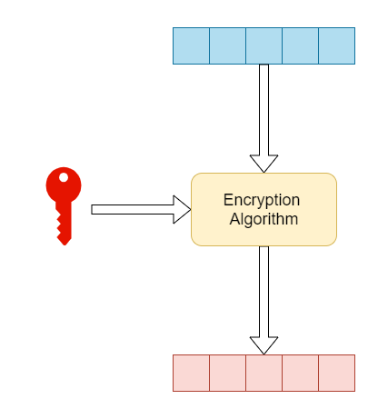
Private Key Encryption Types
Block Ciphers
Encrypt one data block at a time (typically 64 bits, 128 bits, or 256 bits)
Used for a single message
Some common block ciphers are:
DES (Data Encryption Standard),
Triple DES
IDEA (International Data Encryption)
RC5 (Rivest Cipher 5)

Slide 11
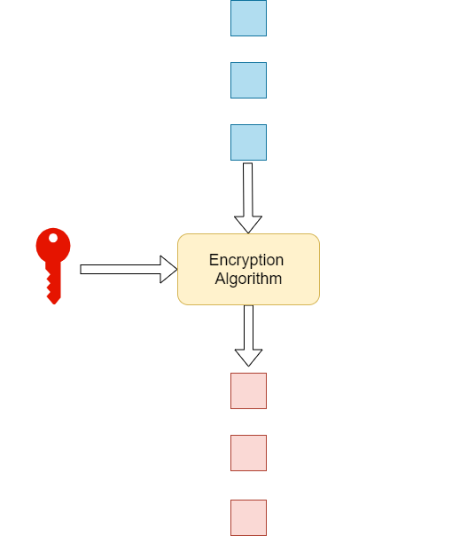
Private Key Encryption: Types continued…
2 . Stream Ciphers
Encrypt one bit of data at a time
Used when data is stream of information.
Example: RC4

Slide 12
Advantages and Disadvantages of Private Key Encryption
Advantages:
User must remember only one key to encrypt and decrypt data.
Performance is faster compared to public key encryption.
Disadvantages:
Key must be stored securely. If an attacker gets access to this key, then he can decrypt any data.
A secured channel is required to transfer the key.

Slide 13
Public Key Encryption (Asymmetric Key Encryption)

Slide 14
Public Key Encryption (Asymmetric Key Encryption)
Whitfield Diffie and Martin E. Hellman’s 1976 paper ‘New Directions in Cryptography’ introduced the idea of public and private key cryptography.
Public key encryption is an encryption technique that uses public and private keys to encrypt and decrypt the data.
Public Key is public and known to everyone. The message sender uses the recipient's public to encrypt a message.
Private key belongs only to the owner. It is used to decrypt messages encrypted by the matching public key.

Slide 15
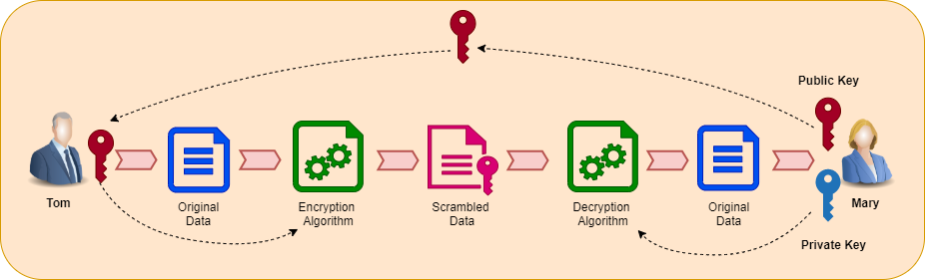
Example
Tom wants to send has a sensitive data to Mary.
Mary creates a private and public key. She keeps the private key to herself and gives the private key to Tom.
Tom uses the public key provided by Mary to encrypt the data.
When Mary gets the encrypted data, she uses her private key to decrypt that data.

Slide 16
Why Public Key Encryption works?
Data is encrypted using the public key in a way that there is a large number of possible solutions available.
To decrypt data, one would need to test every single solution until the right solution is not found out. This process can take 100 years.
So common public key encryption algorithms are:
RSA(Rivest–Shamir–Adleman)
EIGamal Encryption
ECC (Elliptic curve cryptography)

Slide 17
Advantages of Public Key Encryption
No need to exchange keys
Private key can not be derived from public key.
The confidentiality of the message can be ensured by using the public key cryptography
It is possible to establish authentication of the sender by using public key cryptography (digital signature)

Slide 18
Disadvantages of Public Key Encryption
Slower compared to symmetric key encryption.
As the public key is public to everyone. There is now way to validate who the sender is.
Public key Encryption is vulnerable to Brute-force attack.
This encryption becomes highly vulnerable if the user loses his private key.
It is also weak towards man in the middle attack. A third party can disrupt the public key communication and modify the public keys. Now, when the sender encodes it with the modified public key, the receiver cannot decode it.

Slide 19
Applications
Message Encryption and Decryption: Sender encrypts a message with receiver’s public key and receiver decrypts the data using his/her private key.
Digital Signatures: Sender “signs” a message with its private key and sends to receiver. This will ensure the authenticity of the sender because receiver can decrypt the cipher using sender’s private key.
Key exchange: Share a symmetric session key using asymmetric encryption.
The client encrypts a random (symmetric) key with a server’s public key. The server decrypts this shared key and uses it to encrypt data. This symmetric key is also called session key.
This session key will be used to encrypt and decrypt data that will be transferred from both sides.
Once the session is over the session key is discarded and a new session key is created for each session

Slide 20
Combining the merits of Public and Private Key Encryption
Public key encryption is more secure because it uses two keys to encrypt and decrypt the data. However, it is slow.
Whereas private key encryption is good with performance because only one key is used to encrypt and decrypt the data.
So, we can use public key encryption to exchange a private encryption key and once both sender and receiver have the private encryption key, they can use it to communicate and transfer data to each other.

Slide 21
RSA Algorithm

Slide 22

RSA Algorithm:
Developed by Rivest–Shamir–Adleman of MIT in 1976
RSA is the most popular public key encryption algorithm used for encryption and decryption.
Relies on the fact that finding prime factors of large prime numbers is very difficult.

Slide 23
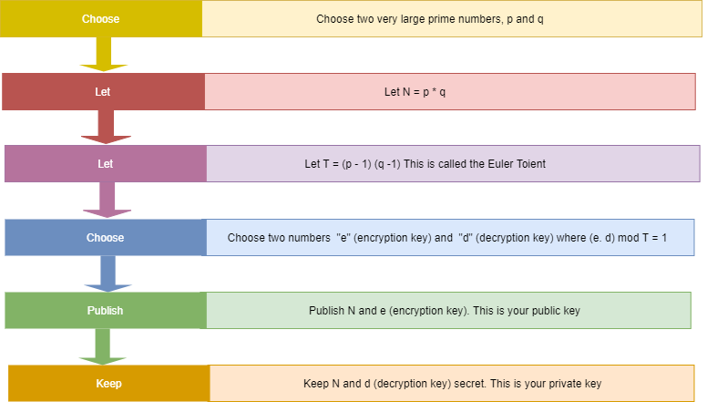
Key Generation

Slide 24
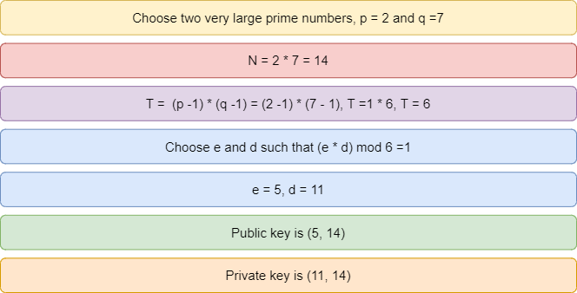
RSA Example

Slide 25
Message Encryption
The public key is (5, 14) (see above image).
Let’s send a one-letter secret message ‘B’. Consider ‘B’ is represented by number 2. Like A =1, B=2, C=3 ….so on.
Encryption value = Message^{e}mod N
= 2⁵ mode 14
= 32 mod 14
= 4
Thus, 4 is the encrypted message, which translates to letter “D”.

Slide 26
Message Decryption
The public key is (5, 14).
The private key is (11, 14).
Let’s translate “D” (encoded message) to number 4. Like A =1, B=2, C=3 ….so on.
Decrypted value = encyptedMessage^{d} mode N
= 4¹¹mode 14
= 2
Thus, 2 is the encrypted message, which is translated to letter ‘B’.

Slide 27
References
https://ebrary.net/26701/computer_science/advantages_public_cryptography
https://www.guru99.com/difference-encryption-decryption.html
https://www.thesslstore.com/blog/difference-encryption-hashing-salting/
https://cheapsslsecurity.com/p/what-is-public-key-and-private-key-cryptography-and-how-does-it-work/
https://slideplayer.com/slide/8016260

